Slide 1
UNIFICATION OF ITALY
1848 - 1870

Slide 2
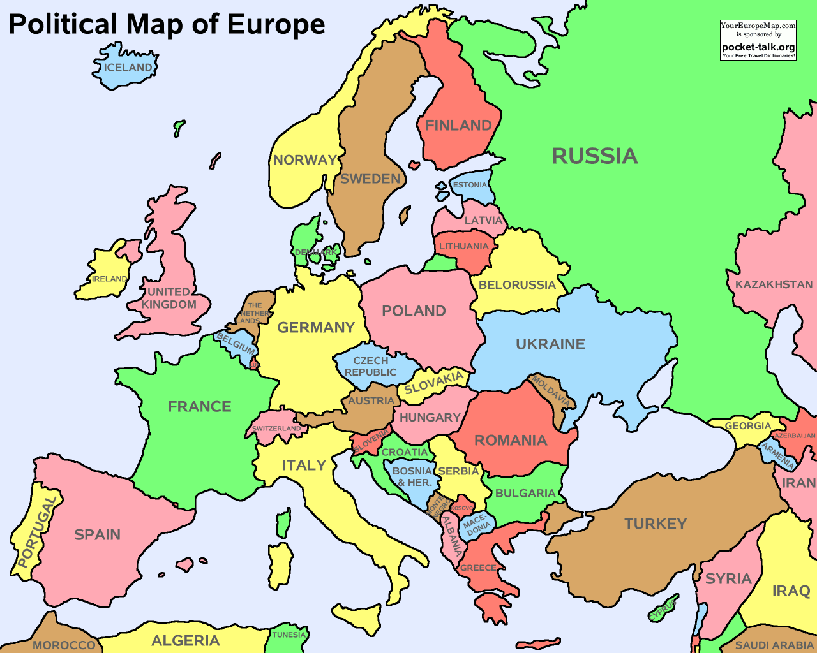

Slide 3
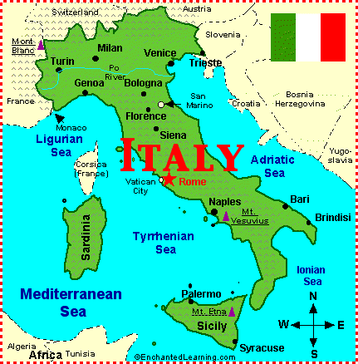

Slide 4
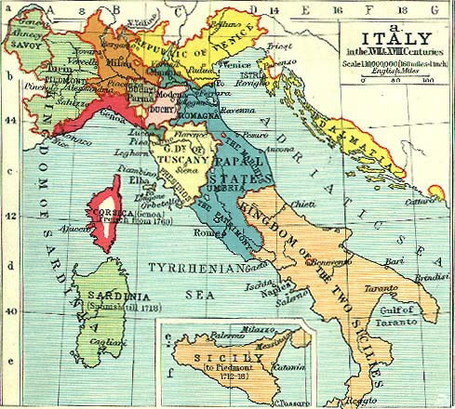

Slide 5
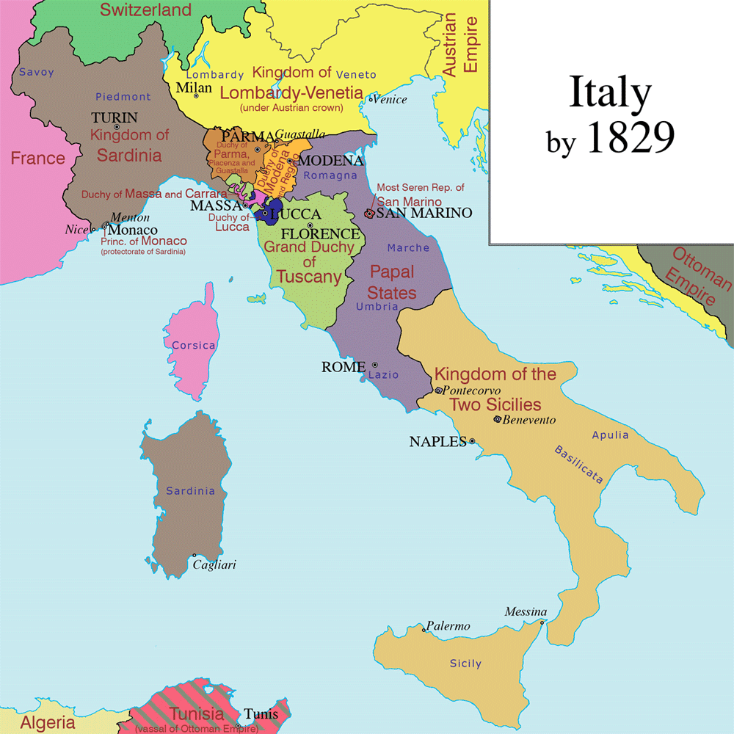

Slide 6
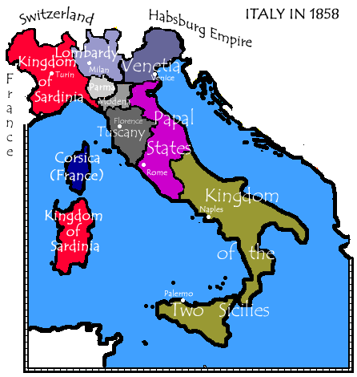

Slide 7
CIRCUMSTANCES
VIENNA SETTLEMENT OF 1815
NOT JUSTICE TO ITALY
GEOGRAPHICAL EXPRESSION
REVOLUTIONS OF FRANCE
1789, 1830, 1848
REVOLTS IN ITALY
1820 : NAPLES
1821 : PIEDMONT
1830 : LOMBARD, PIEDMONT,
PARMA and MODENA

Slide 8
CIRCUMSTANCES
PEOPLE’S MOVEMENT (SECRET SOCITIES)
CARBONARI : Expulsion of Foreigners and Achievement of Constitutional Freedom
RISORGIMENTO : Free and United Italy
Political Prisoners… Parliamentary Form of Government, Freedom of Press, Reduction of Church Power and Establishment of Republic

Slide 9
CIRCUMSTANCES
PEOPLE’S MOVEMENT (SECRET SOCITIES)
YOUNG ITALY : 1831, Giuseppe Mazzini
Liberation And Unification By Young Men. Free, Independent and Republican Italy.
EMERGENCE OF ENLIGHTENED PERSONALITIES
GIUSEPPE MAZZINI (1805-1872) : Unification of Italy by the Union of Young Men
GIUSEPPE GARIBALDI (1807-1882)
CAMILLO BENSO DI CAVOUR (1810-1861)

Slide 10
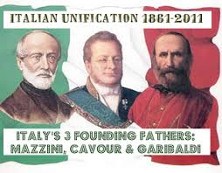
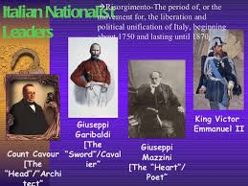

Slide 11
UNIFICATION MOVEMENT…
CHARLES ALBERT: KING OF SARDINIA
POPE PIUS IX: 1846, LIBERAL…
UPRISINGS….. 1846-1848…. CHARLES….
VICTOR EMMANUVEL II: 1848.. SARDINIA
1859 : WAR WITH AUSTRIA ...SAR-FREE
1860: PLEBISCITES IN LOMBARDY, TUSCANY, PARMA, MODENA, ROMANGA
1860: ONE THOUSAND ATTACK-GARIBALDI
1860:PLB: SICILY, NAPLES, PAPEL PROVINCE

Slide 12
UNIFICATION MOVEMENT…
1866: SEVEN WEEKS WAR: VENETIA (NAP.III)
PRUSSIA+NEW ITALY x AUSTRIA
1870: OCCUPATION OF ROME- 20.09.1870
PROTECTED BY NAP.III
FRANCO PRUSSIAN WAR.1870
NAP.III RECALLED HIS MILITARY
ITALIAN TROOPS.20 SEP 1870
ADVICE TO POPE
PLEBISCITE: 134000:1500
ONE ITALY: ROME: CAPITAL
VICTOR IMMANUEL.II: EMPEROR

